Slide 1
Lecture 3:
Security Monitoring and Detection

Slide 2
Objectives
Understand Log and event collection: sources and formats
Understand SIEM systems overview (Splunk, ELK, QRadar)
Understand Indicators of Compromise (IoC) and Tactics, Techniques, and Procedures (TTPs)
Understand Real-time monitoring and anomaly detection

Slide 3
Introduction
Security monitoring and incident detection enable SOC analysts to protect organizations from cyber threats. They provide real-time visibility into IT environments, allowing swift identification of anomalies. Analysts monitor network traffic, logs, and user activities to detect suspicious behavior early. Collecting, correlating, and analyzing logs and events are key SOC functions.

Slide 4
Log and event collection Sources and Format

Slide 5
Log and Event Collection
Log and event collection involves gathering data from various sources within an organization's IT infrastructure. These sources include:
  Network Devices: Routers, switches, firewalls.
  Servers: Web servers, database servers, application servers.
  Endpoints: Workstations, laptops, mobile devices.
  Security Devices: Intrusion detection/prevention systems (IDS/IPS) and antivirus software.
  Applications: Custom applications, cloud services

Slide 6
Log and Event Correlation
Log correlation is the process of analyzing log data from different sources to identify patterns or sequences of events that may indicate a security threat. This involves:
  Time-Based Correlation: Matching events that occur within a specific time frame.
  Rule-Based Correlation: Using predefined rules to identify suspicious activities.
  Pattern-Based Correlation: Detecting known attack patterns.
  Topology-Based Correlation: Understanding the network topology to correlate events more effectively

Slide 7
Log and Event Analysis
Log analysis involves examining collected log data to detect and investigate security incidents. This process includes:
  Normalization: Converting log data into a consistent format for easier analysis.
  Aggregation: Combining similar events to reduce the volume of data.
  Alerting: Generating alerts for suspicious activities based on predefined criteria.
  Visualization: Using dashboards and reports to present log data in an understandable way.

Slide 8
Security Information and Event Management (SIEM) Systems

Slide 9
What is SIEM?
Security Information and Event Management (SIEM) systems are critical tools utilized within Security Operations Centers (SOCs)
SIEM systems collect, aggregate, and analyze log and event data from various sources within an organization's IT infrastructure. This data is used to detect, investigate, and respond to security incidents in real-time.
These systems play a central role in enhancing cybersecurity by providing comprehensive visibility into security events and facilitating timely incident detection and response.

Slide 10
Key Components of SIEM
Log Management involves collecting and storing log data from various sources, such as network devices, servers, and applications.
Event Correlation: Analyzing log data to identify patterns or sequences of events that may indicate a security threat.
Continuous Monitoring: Providing real-time visibility into an organization's security posture.
Incident Response: Enabling quick detection and response to security incidents

Slide 11
Benefits of SIEM
Enhanced Threat Detection: By correlating data from multiple sources, SIEM systems can detect complex threats that might go unnoticed by individual security tools.
Improved Incident Response: SIEM systems provide actionable insights that help security teams respond to incidents more effectively.
Compliance: SIEM systems help organizations meet regulatory requirements by maintaining detailed logs and audit trails

Slide 12
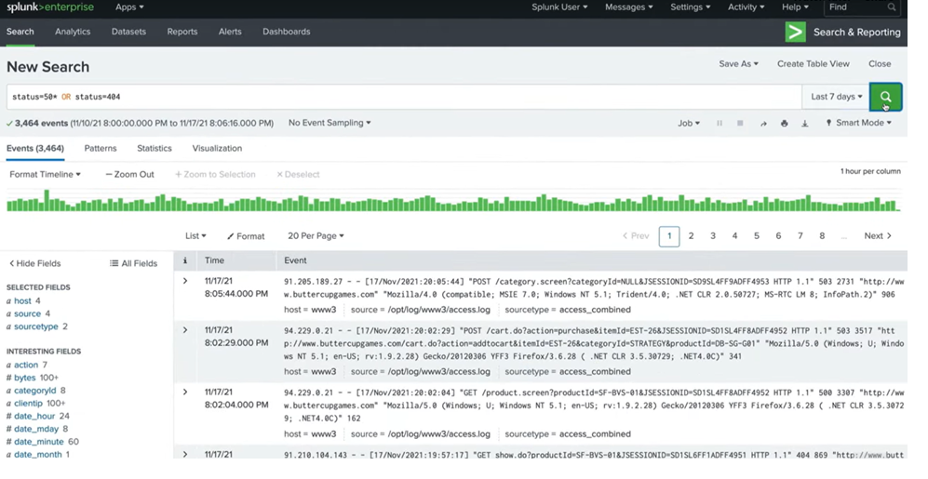
An overview of common SOC tools & Technologies
Example: Splunk Enterprise Security is a SIEM platform that provides real-time monitoring, advanced analytics, and incident response capabilities. It collects and correlates security events from various sources, enabling security analysts to detect and respond to threats more efficiently.

Slide 13
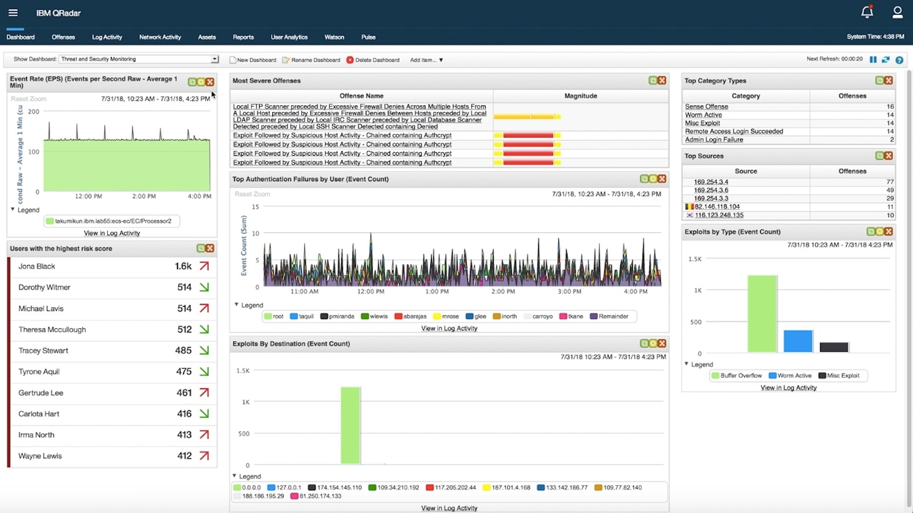
An overview of common SOC tools & Technologies
Example: IBM QRadar is a network security management platform that provides situational awareness and compliance support. QRadar uses a combination of flow-based network knowledge, security event correlation, and asset-based vulnerability assessment.

Slide 14

An overview of common SOC tools & Technologies
Example: Microsoft ArcSight Enterprise Security Manager (ESM) is a great, adaptable SIEM that offers comprehensive data collection and real-time threat analysis, along with a native threat intelligence feed and native SOAR.
Splunk has a 56.53% market share in the Security Information And Event Management (SIEM) category, while Micro Focus ArcSight ESM has a 1.17% market share in the same space.
https://www.opentext.com/products/arcsight-enterprise-security-manager

Slide 15
Indicators of Compromise (IoC) and Tactics, Techniques, and Procedures (TTPs)

Slide 16
Indicators of Compromise (IoC)
Indicators of Compromise (IoCs) are pieces of forensic data that suggest a network or system has been breached. They help security professionals detect and respond to potential threats. Examples of IoCs include:
Unusual Network Traffic: Unexpected spikes or patterns in network traffic.
Unexpected Software Installations: Installation of software without user consent.
Anomalous User Behavior: Sign-ins from unusual locations or at odd times.
Changes to System Configurations: Unauthorized modifications to system settings

Slide 17
Tactics, Techniques, and Procedures (TTPs)
Tactics, Techniques, and Procedures (TTPs) describe the behaviour and methods used by threat actors to carry out cyberattacks. Understanding TTPs helps organizations anticipate and defend against potential threats. Here's a breakdown:
Tactics: The overall strategy or goal of the threat actor (e.g., data exfiltration).
Techniques: The general methods used to achieve the tactic (e.g., phishing).
Procedures: The specific steps taken to execute the technique (e.g., crafting a phishing email with a malicious link)

Slide 18
Example of IoC and TTPs:
Indicator of Compromise (IoC) Example:
  Suspicious outbound network traffic to known malicious IP addresses.
  Unexpected modifications to critical system files.
  Anomalous login attempts from unfamiliar locations or devices.
Tactics, Techniques, and Procedures (TTPs) Example:
  Phishing emails containing malicious links or attachments to deliver malware.
  Exploiting software vulnerabilities to gain unauthorized access to systems.
  Using stolen credentials to move laterally within a network and escalate privileges.

Slide 19
Real-time monitoring and anomaly detection

Slide 20
Real-Time Monitoring
Real-time monitoring involves continuously observing an organization's IT infrastructure to detect and respond to security incidents as they happen. Key components include:
Security Information and Event Management (SIEM): Collects and analyzes log data from various sources to provide real-time alerts.
Network Monitoring Tools: Track network traffic and identify unusual patterns.
Endpoint Detection and Response (EDR): Monitors endpoints like computers and mobile devices for suspicious activity.

Slide 21
Anomaly Detection
Rule-Based Detection (Signature-Based)
  Uses predefined signatures of known attacks (e.g., malware hash, known bad IPs).
  Effective for detecting known threats but fails against zero-day attacks.
Behavioral-Based Detection
  Establishes a baseline of normal behaviour and detects deviations.
  Helps detect insider threats and zero-day attacks.
Machine Learning & AI-Based Detection
  Uses algorithms to analyze large datasets and identify anomalies.
  Can detect complex attacks like fileless malware and low-and-slow attacks.
User and Entity Behavior Analytics (UEBA)
  Monitors user activities and detects deviations from usual patterns.
  Example: If an employee logs in from two different countries within an hour, it's flagged as impossible travel.

Slide 22
Key Anomalies to Detect in Cybersecurity
Unusual Network Traffic
  Large data transfers outside normal business hours.
  Traffic to or from known malicious IP addresses.
Unauthorized Access Attempts
  Multiple failed login attempts (brute-force attacks).
  Logins from unusual locations (e.g., foreign IPs).
Unusual File Modifications
  Sudden encryption of multiple files (ransomware attack).
  Creation of new admin accounts.
Process and Service Anomalies
  Unexpected execution of PowerShell or script files.
  Malware or unauthorized software running in memory.

Slide 23
Benefits
Early Threat Detection: Identifies potential threats before they can cause significant damage.
Improved Incident Response: Enables quicker and more effective responses to security incidents.
Reduced False Positives: Advanced techniques help minimize false alarms, allowing analysts to focus on genuine threats.

Slide 24
Tools for Real-Time Monitoring & Anomaly Detection
SIEM Solutions: Splunk, ELK Stack, Microsoft Sentinel.
EDR Solutions: CrowdStrike Falcon, Carbon Black, SentinelOne.
NTA Solutions: Darktrace, ExtraHop, Corelight.
AI/ML-Based Solutions: Palo Alto Cortex XDR, Vectra AI, Exabeam.

Slide 25
Summary of Real-Time Monitoring & Anomaly Detection
In summary, real-time monitoring and anomaly detection are critical capabilities for SOC operations, enabling organizations to detect and respond to security threats effectively.
Real-time monitoring provides continuous visibility into the organization's IT environment, while anomaly detection helps identify abnormal behaviors or activities that may indicate potential security incidents. Together, these capabilities empower organizations to detect and mitigate security threats promptly, enhancing their overall cybersecurity posture.
By combining real-time monitoring with anomaly detection methods, organizations can enhance their ability to detect and respond to security threats effectively, improving their overall cybersecurity posture.

Slide 26
Activities
Generate login events in Windows/Linux and view logs

Slide 27
SOC tools(Reference)
1. Log Collection & Centralization: SOC teams need to aggregate logs from endpoints, servers, network devices, and cloud services.
  Syslog Servers – Collect logs from various sources (e.g., Rsyslog, Syslog-ng).
  Log Management Solutions – Provide search and storage (e.g., Graylog, Logstash).
2. Security Information and Event Management (SIEM): SIEM platforms correlate, analyze, and visualize logs to detect threats.
  Splunk Enterprise Security
  IBM QRadar
  Microsoft Sentinel (cloud-native SIEM)
  Elastic Security (ELK Stack)
  Wazuh (Open-source SIEM & XDR)
3. Endpoint Detection & Response (EDR): Monitors endpoint activity for suspicious behavior and supports incident response.
  CrowdStrike Falcon
  SentinelOne
  Microsoft Defender for Endpoint
  Sophos Intercept X
  OSSEC (open-source)
🔹 4. Network Security Monitoring (NSM): Captures and analyzes network traffic for signs of compromise.
  Zeek (formerly Bro)
  Suricata (IDS/IPS engine)
  Snort (IDS/IPS)
  Security Onion (NSM platform with Zeek, Suricata, ELK, Wazuh)

Slide 28
SOC tools(Reference)
5. Threat Intelligence Platforms (TIPs): Provide IoCs (indicators of compromise) and threat actor behavior information.
  MISP (Malware Information Sharing Platform – open-source)
  Anomali ThreatStream
  Recorded Future
  AlienVault OTX (Open Threat Exchange)
6. Security Orchestration, Automation, and Response (SOAR): Automates repetitive SOC workflows and incident response.
  Splunk SOAR (formerly Phantom)
  Cortex XSOAR (Palo Alto Networks)
  Swimlane
  Shuffle (open-source SOAR)
7. Vulnerability Management & Scanning: Identify weaknesses in endpoints, applications, and networks.
  Nessus
  Qualys VMDR
  OpenVAS (open-source)
  Rapid7 InsightVM
8. Incident Response & Forensics Tools: Used to investigate and remediate security incidents.
  FTK (Forensic Toolkit)
  Autopsy / Sleuth Kit
  Volatility (memory forensics)
  Velociraptor (endpoint forensics & IR)

Slide 29
SOC tools(Reference)
9. Case Management & Ticketing: SOC analysts need workflow tools for triage and escalation.
  ServiceNow Security Operations
  Jira (with security plugins)
  TheHive Project (open-source)
10. User and Entity Behavior Analytics (UEBA): Detects insider threats and compromised accounts by analyzing behavioral baselines.
  Exabeam
  Splunk UEBA
  Microsoft Sentinel UEBA

Slide 30

REFERENCES
Jarpey, G., & McCoy, R. S. (Year). Security Operations Center Guidebook: A Practical Guide for a Successful SOC (Chapters 3 & 4). Publisher.
ClearNetwork, Inc. SOC analysts: How they identify and respond to security incidents. Retrieved from [https://www.clearnetwork.com/]
DarktraceReimagining your SOC: Overcoming alert fatigue with AI-led investigations. Darktrace Blog. Retrieved from [https://darktrace.com/]
[MindPoint Group’s]. What types of logs or data can be sent to a SOC? Retrieved from [https://www.mindpointgroup.com/]
Microsoft. What are indicators of compromise (IoC)? Microsoft Security. Retrieved from [https://learn.microsoft.com/]
Security Operations Center Guidebook
A Practical Guide for a Successful SOC
Gregory Jarpey and R. Scott McCoy
Chapter 3 and 4

